Slide 1

Building a Modern Cross-Platform App
Brent Edwards
Principal Lead Consultant
Magenic
Level: Intermediate

Slide 2
Brent Edwards
BrentE@magenic.com
@brentledwards
http://www.brentedwards.net
https://github.com/brentedwards

Slide 3




MyVote App Architecture
HTML 5 UI
iOS UI
UWP UI
Android UI
JavaScript BL
BL
BL
BL
Service Proxy
Data Portal
Data Portal
Data Portal
Reports
SQL Reporting
REST API
Data Portal
ASP.NET WA
BL
Excel
DAL
PowerPivot
SQL Database
Blobs
Notes:
This is the MyVote architecture as it stands today.
We’re going to look at how we got to this point.

Slide 4
MyVote Client Apps
Notes:
Break time?

Slide 5
MyVote Client Apps
Goals
As many platforms as possible (for us)
Match platform look-and-feel
Maximize code re-use

Slide 6
MyVote Client Apps
Technology Options
Fully Native
No code re-use
Cross-platform solution
Xamarin
PhoneGap

Slide 7
MyVote Client Apps
Our Technology Decision
Universal Windows Platform
Xamarin.Forms for Android/iOS
JavaScript for Web
Least ability for re-use
Allen will cover this later

Slide 8
What is Xamarin?

Slide 9
What is Xamarin?
A way to build native apps for iOS and Android using C#
Built on the Mono framework
Still have to write different code for each platform’s UI

Slide 10
What is XAMARIN.FORMS?

Slide 11
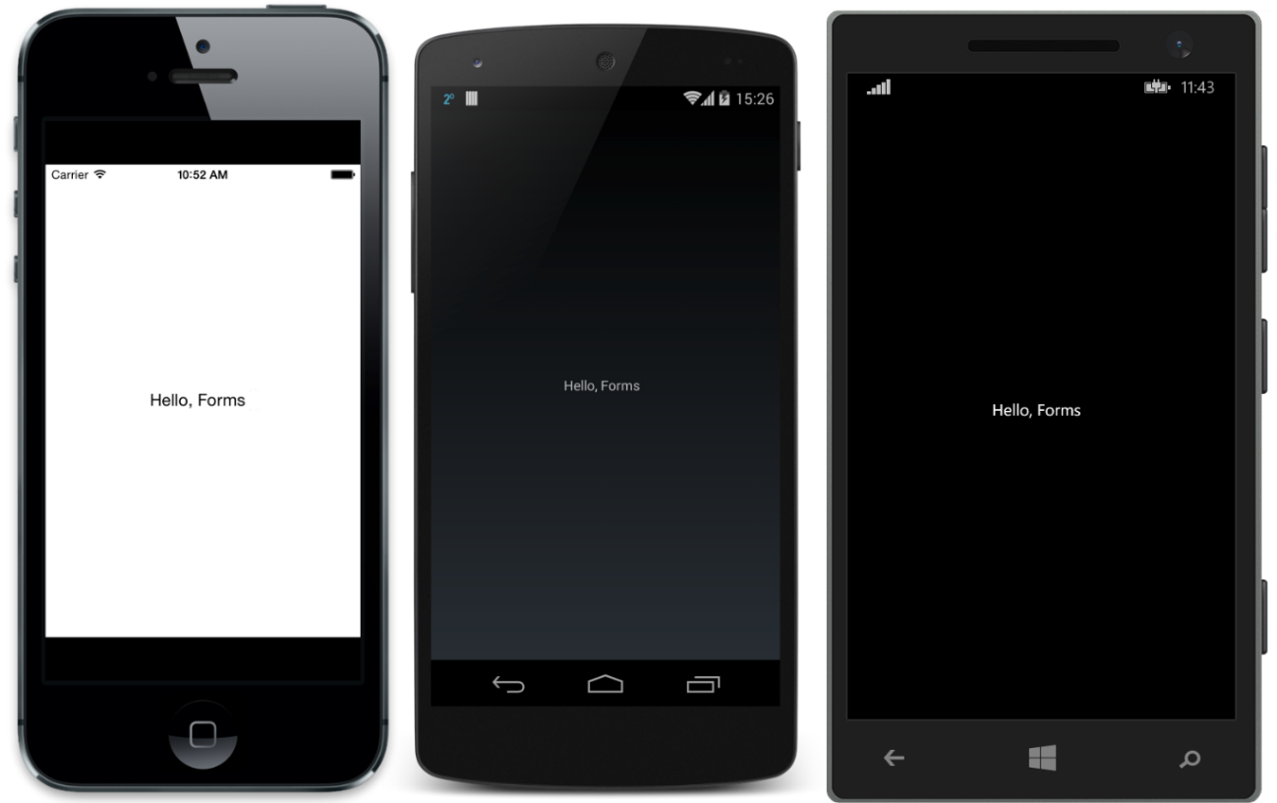
What is Xamarin.Forms?
Source: http://developer.xamarin.com/guides/cross-platform/xamarin-forms/introduction-to-xamarin-forms/

Slide 12
What is Xamarin.Forms?
A UI abstraction layer for Xamarin
Write apps once, run on:
iOS
Android
Windows Phone

Slide 13
What is Xamarin.Forms?
Suite of controls that map to native controls on each platform
Rendered with native look-and-feel
Framework for navigation and data binding

Slide 14
How does it work?
Xamarin.Forms Solution
Xamarin.Android Project
Native Android
Xamarin.iOS Project
Native iOS
Windows Phone Project
Native Windows Phone

Slide 15
Foundation

Slide 16
Xamarin.Forms Foundation
4 Main Classes everything is built on
View
Page
Layout
Cell

Slide 17
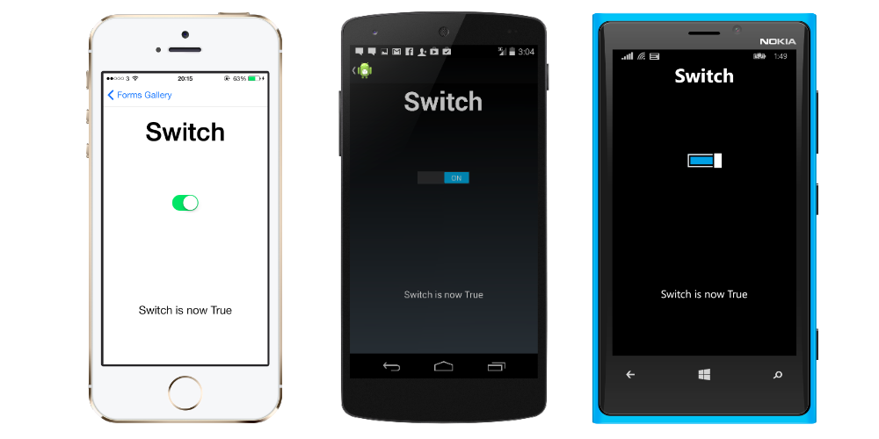
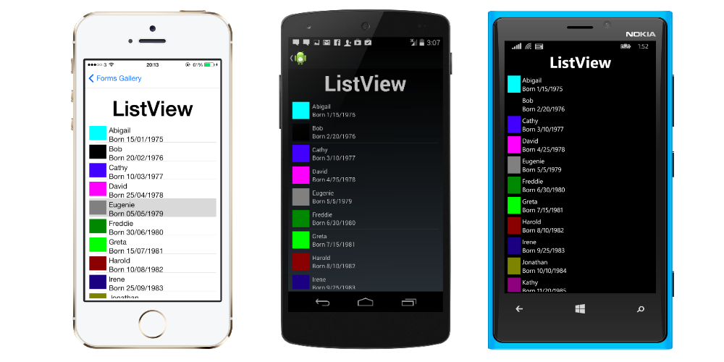
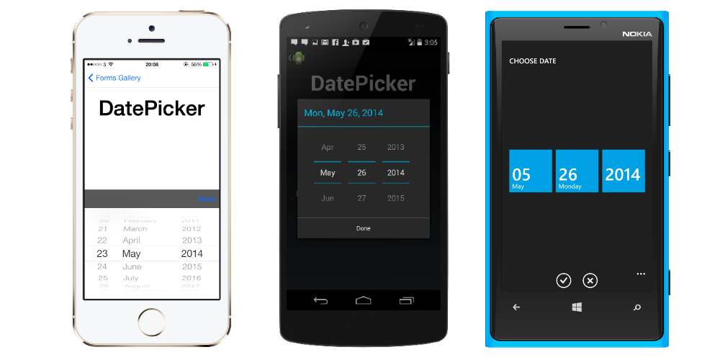
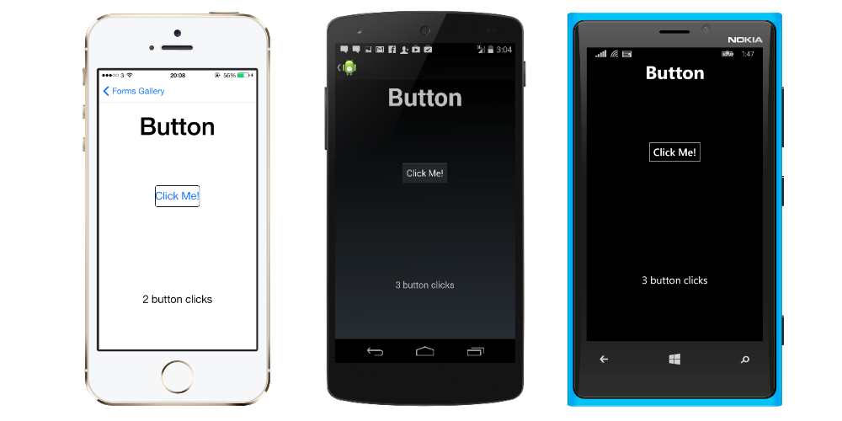
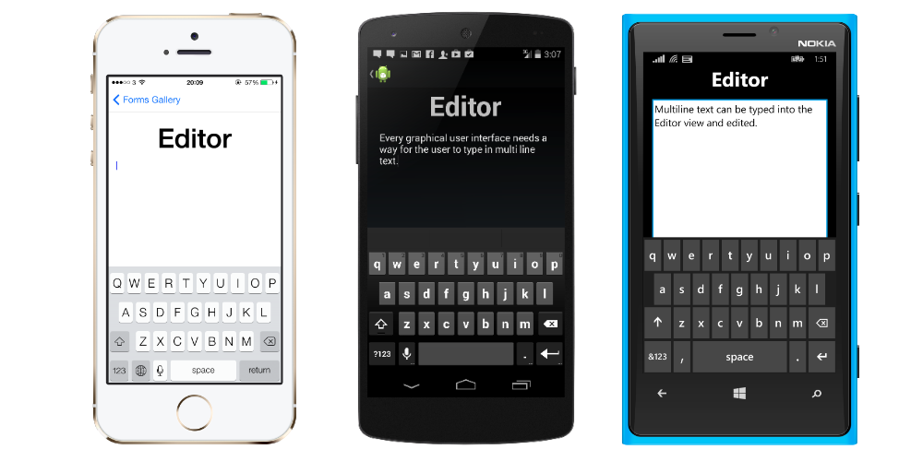
View
Typically called control or widget on native platforms
Examples:
Button
Editor
DatePicker
ListView
Switch

Slide 18
Page
Android
Activity
iOS
View Controller
Windows Phone
Page

Slide 19
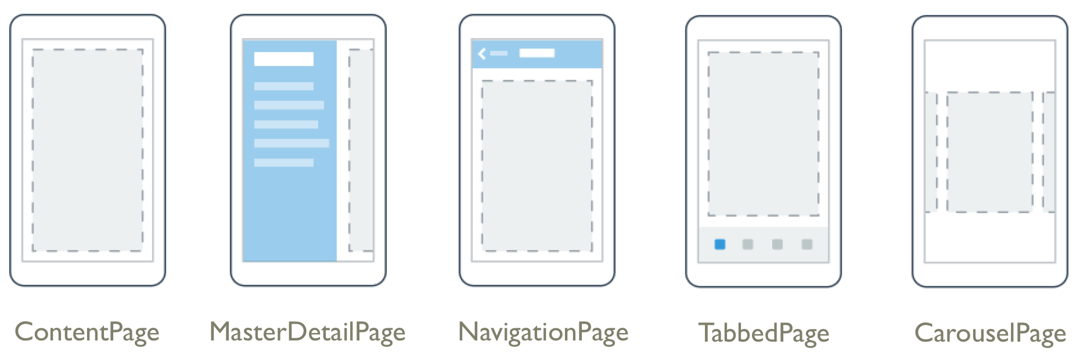
Page Examples
Source: http://developer.xamarin.com/guides/cross-platform/xamarin-forms/controls/pages/

Slide 20
Layout
Type of view used for… Layout!
Container for other Layouts or Views
2 Types
Managed
Unmanaged

Slide 21
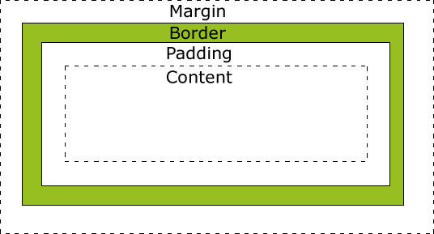
Managed Layout
Handles sizing and positioning child views
Follow CSS Box Model
Source: http://www.w3schools.com/css/css_boxmodel.asp

Slide 22
Unmanaged Layout
Does not handle sizing and positioning of child views
Developer sets this
Allows for precise positioning
Requires testing on many device sizes

Slide 23
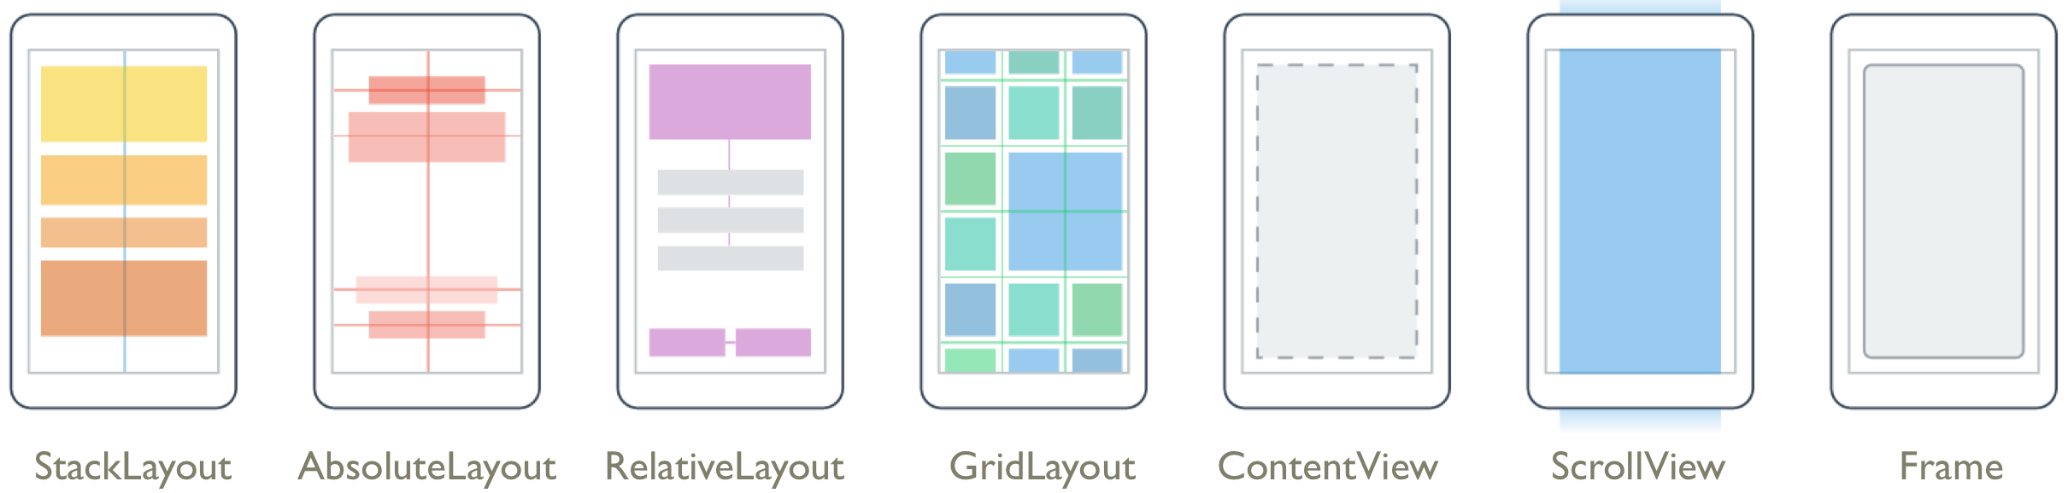
Layout Examples
Source: http://developer.xamarin.com/guides/cross-platform/xamarin-forms/controls/layouts/

Slide 24
Cell
Describes how items in a list or table should be drawn
Not a visual element
Like a DataTemplate in XAML
Designed for ListView and TableView

Slide 25
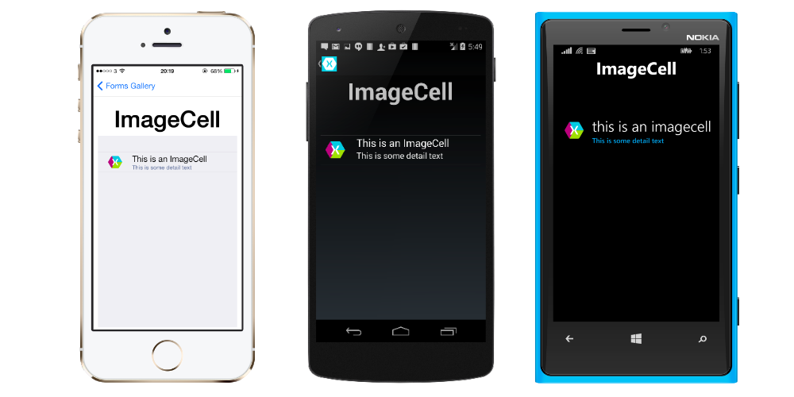
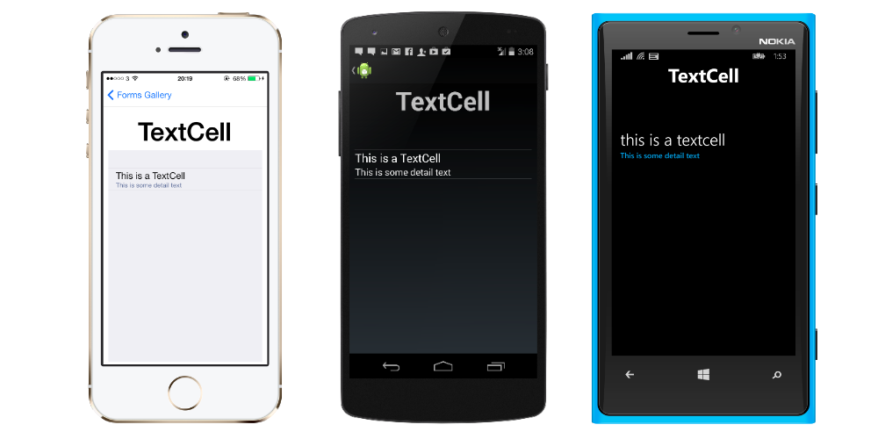
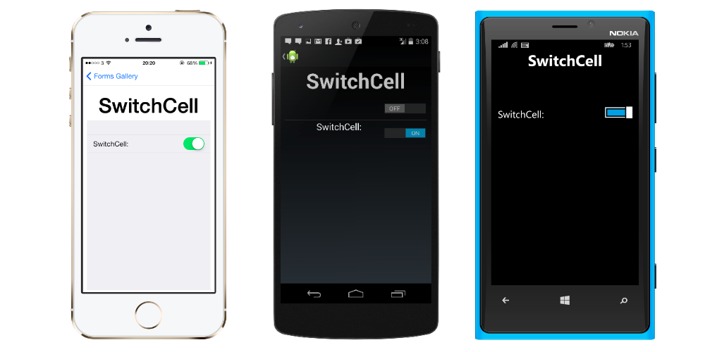
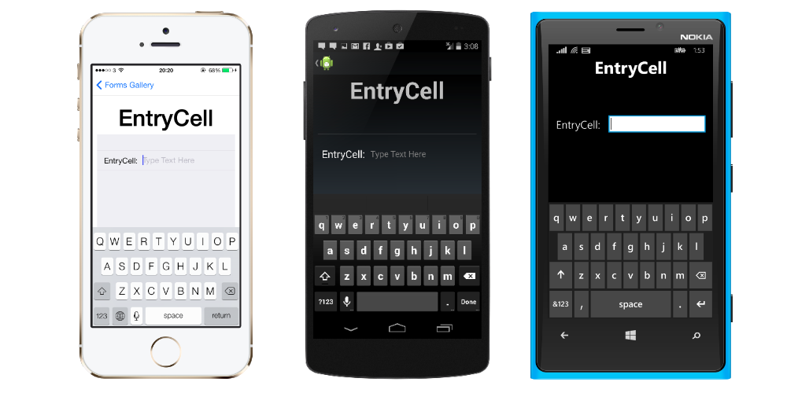
Cell
Examples:
EntryCell
SwitchCell
TextCell
ImageCell

Slide 26
Xamarin.Forms UI
[DEMO]

Slide 27
Going Custom

Slide 28
Going Custom
What about custom controls?
Create a custom Renderer!
Renderers output native controls for each platform
All controls use Renderers

Slide 29
Custom Renderers
Can tweak existing controls
Can create completely new controls
Lots of power

Slide 30
Custom Renderers
How to do it
Create custom control
Can inherit from existing types
Create custom renderer for each platform
This dives into Xamarin proper
Bind them together with ExportRenderer attribute
Tells Xamarin that they are a pair

Slide 31
Custom Renderers
[DEMO]

Slide 32
Universal Windows Platform

Slide 33
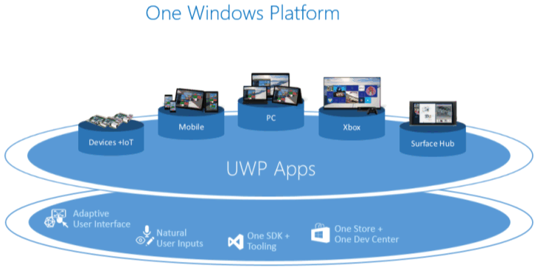
Universal Windows Platform
Source: https://msdn.microsoft.com/en-us/library/windows/apps/dn894631.aspx

Slide 34
UWP Device Families
Windows 8.1/Windows Phone 8.1 target an OS
Windows 10 provides common app platform
Targets Device Families
One package for all

Slide 35
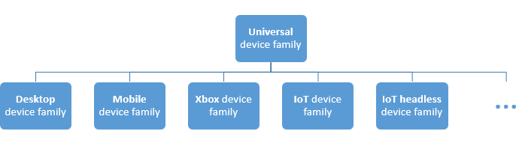
UWP Device Families
Source: https://msdn.microsoft.com/en-us/library/windows/apps/dn894631.aspx

Slide 36
UWP Foundation

Slide 37
Universal Stuff
Layouts
Controls
Styles

Slide 38
Example Controls

Slide 39

RelativePanel
Source: https://msdn.microsoft.com/library/windows/apps/windows.ui.xaml.controls.relativepanel.aspx

Slide 40
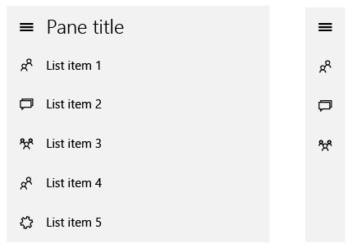
SplitView
Source: https://msdn.microsoft.com/en-us/library/windows/apps/dn997787.aspx

Slide 41
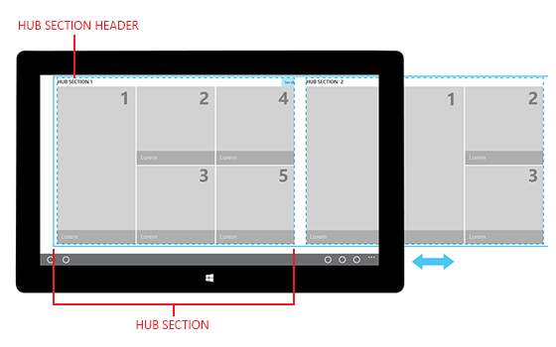
Hub
Source: https://msdn.microsoft.com/en-us/library/windows/apps/dn449149.aspx

Slide 42
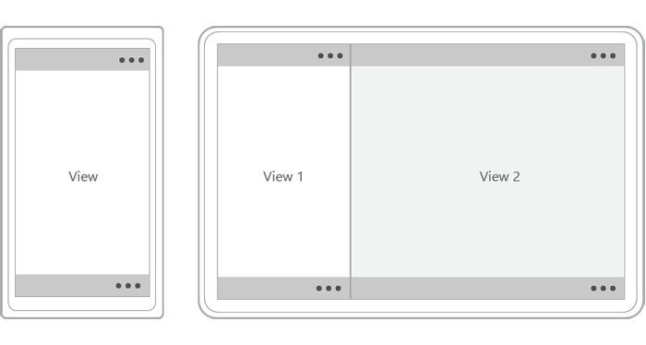
CommandBar
Source: https://msdn.microsoft.com/en-us/library/windows/apps/hh465302.aspx

Slide 43
UI Patterns

Slide 44
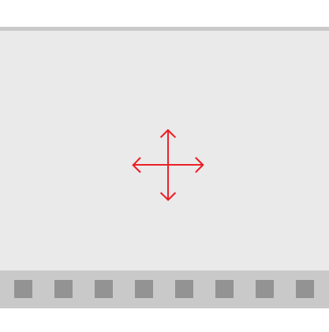
Active Canvas
Source: https://msdn.microsoft.com/en-us/library/windows/apps/dn997761.aspx

Slide 45
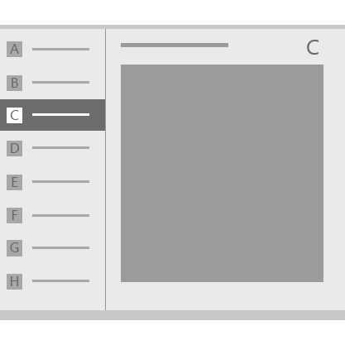
Master/Detail
Source: https://msdn.microsoft.com/en-us/library/windows/apps/dn997765.aspx

Slide 46
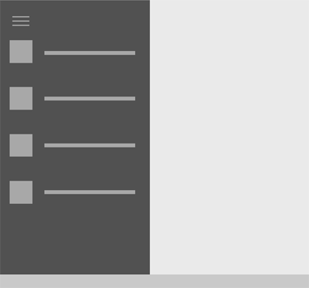
Nav Pane
Source: https://msdn.microsoft.com/en-us/library/windows/apps/dn997766.aspx

Slide 47
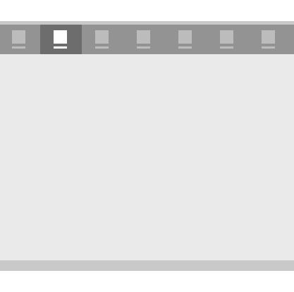
Tabs and Pivots
Source: https://msdn.microsoft.com/en-us/library/windows/apps/dn997788.aspx

Slide 48
Sharing code

Slide 49
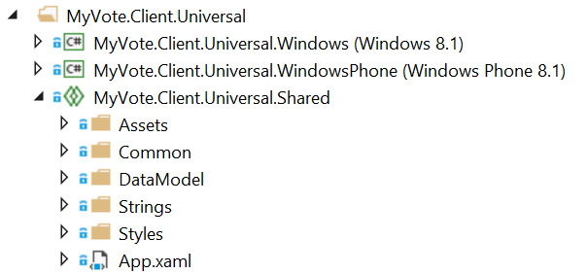
Universal Shared Projects
Essentially a code placeholder project
Does not compile on its own

Slide 50
Universal Shared Projects
Put common code in universal shared project
Platform-specific code in platform-specific projects
What is common?
Models
ViewModels
Converters
Services
What about views?
That depends…

Slide 51
What about Portable Class Library?
What is a PCL?
Single project that compiles for multiple platforms
Drawbacks
Lowest common denominator between platforms
Referenced assemblies must be PCL also
CSLA doesn’t support PCL

Slide 52
Universal Shared Projects
Included with VS 2015
For VS 2013
Shared Project Reference Manager
http://visualstudiogallery.msdn.microsoft.com/315c13a7-2787-4f57-bdf7-adae6ed54450

Slide 53
Windows and Xamarin Apps

Slide 54
Windows and Xamarin Apps
What can be re-used?
Core functionality
Business objects
View Models
Wait… What? How?
We’ll get to that shortly…

Slide 55
Windows and Xamarin Apps
What can’t be re-used?
UI

Slide 56
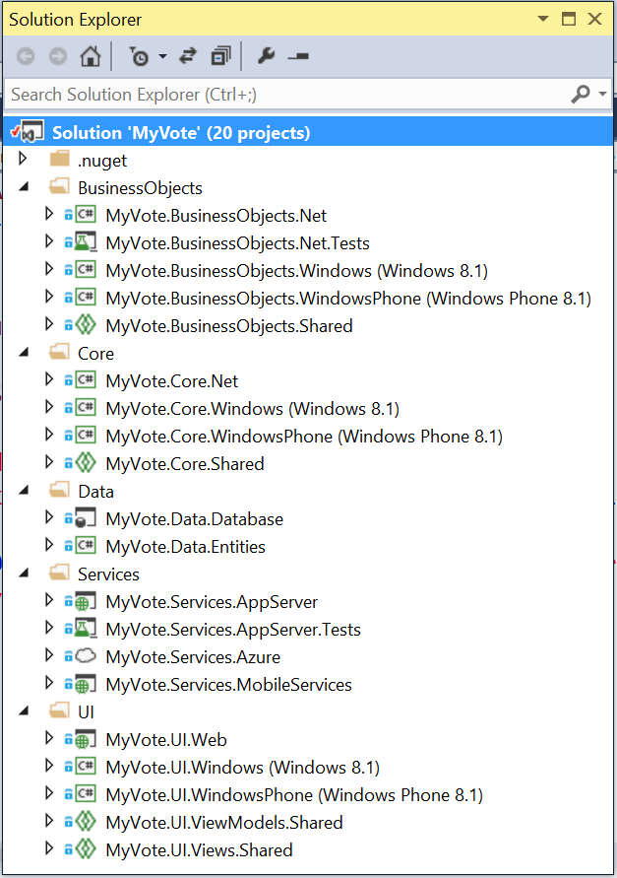
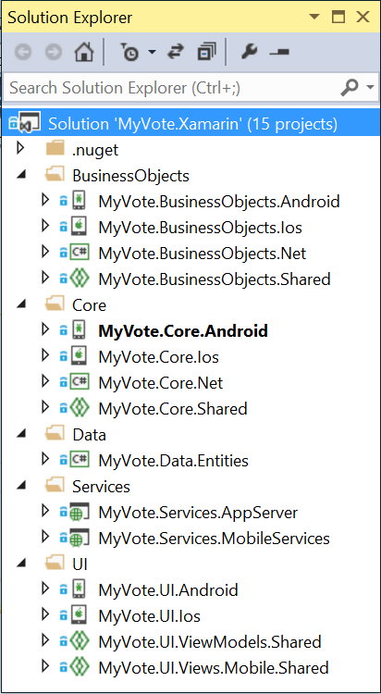
Solution Structure
2 Solutions
Windows/Server
Xamarin
Notes:
Not all team members may be working on Xamarin. Do them a favor and keep the Xamarin stuff seperate.

Slide 57
Maximizing Code Re-Use

Slide 58
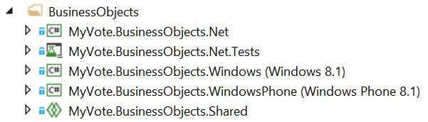
Maximizing Code Re-Use
Universal Shared Projects FTW!
Server
Clients
Shared

Slide 59
Re-Using Code
Foundation
Common code in Universal Shared Projects
Platform-specific projects for each client
Can use
Compiler Directives
Abstraction

Slide 60
Re-Using Code
[DEMO]

Slide 61
MVVM
Model-View-ViewModel

Slide 62
MVVM
View
Presentation
View Model
Presentation Logic
Model
Business Logic

Slide 63
Why is MVVM Cool?
Separates Presentation from Functionality
Promotes Testability
Works great with Data Binding
Easy collaboration with Designers
Makes it easy to change out the View layer!

Slide 64

MvvmCross

Slide 65
MvvmCross
Why use it?
Supports Xamarin.iOS, Xamarin.Android, UWP
Write view model layer once for all platforms

Slide 66
MvvmCross Foundation
Key Stuff
Inherit MvxApplication
Set first View Model or an AppStart
View Models inherit MvxViewModel
Better yet, implement a base ViewModel of your own
Xamarin.iOS
Inherit MvxSetup
Xamarin.Android
Inherit MvxAndroidSetup (which inherits MvxSetup)

Slide 67
MvvmCross Foundation
[DEMO]

Slide 68
UI on Multiple Platforms

Slide 69
UI on Multiple Platforms
Views have to be different
XAML can keep things similar
UWP has great support for responsive layouts
Xamarin.Forms supports their own XAML

Slide 70
Windows

Slide 71
Windows
XAML not as full featured as WPF
Lots of controls to choose from
Too many to list
Support for styling

Slide 72
Multiple Device Families
Can create responsive layouts
Lean on
GridView
RelativePanel
StackPanel
Visual States
AdaptiveTrigger

Slide 73

Xamarin.Forms

Slide 74
Xamarin.Forms
No Visual Designer
No Intellisense for XAML in Visual Studio
Xamarin Studio Windows Doesn’t do iOS
Way fewer controls than Windows out of the box
Up to you to add what you need

Slide 75
UI
[DEMO]

Slide 76
Parting Thoughts

Slide 77
Parting Thoughts
Put thought into solution structure and architecture first
Check out MvvmCross
Focus on one platform at a time
Reduce context switching
Don’t let one platform get too far ahead

Slide 78
Questions?

